Slide 1

WAN Design for Multiple Office Connectivity. Using Cisco Packet Tracer.
Project Topic:
Group members:
P190077 Rana Rehan Qaisar
P190033 Muhammad Istafa Malik
P190045 Muhammad Affan Khan

Slide 2
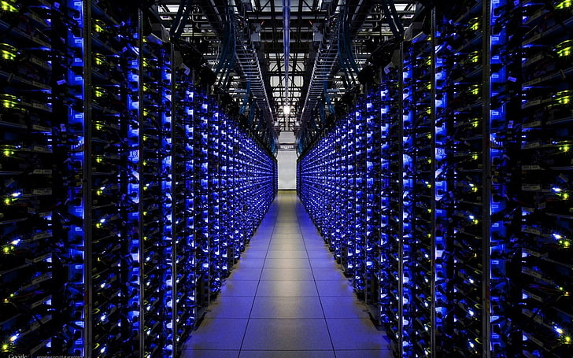
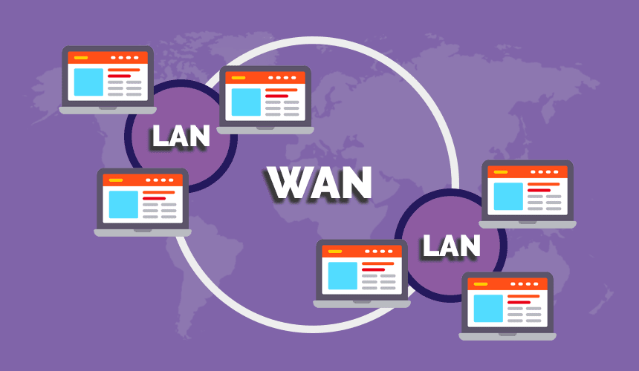
WAN (Wide Area Network):
A wide area network, or WAN, is a geographically scattered network made up of local area networks (LANs) that are linked together to form a single huge network utilizing common carrier services.

Slide 3
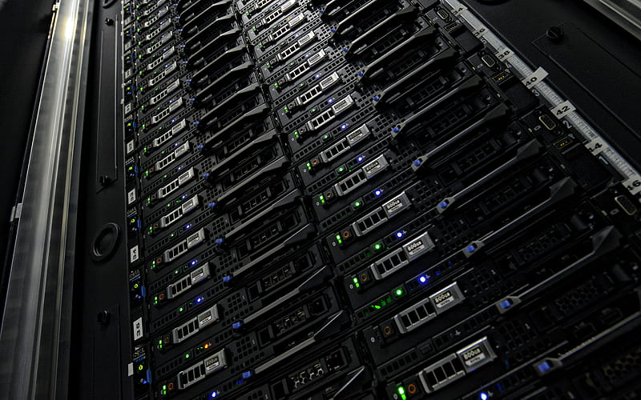
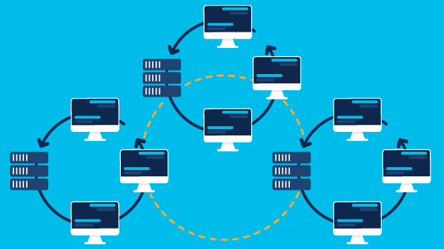
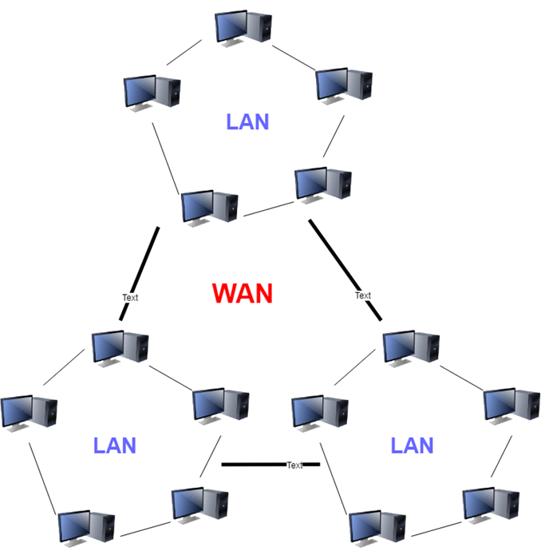
Why WAN is important?
As companies, and organization grow, they open branch offices, hire more employees, and with that there network become more larger.
These changes also influence their requirement for integrated services and drive their network requirement.

Slide 4

Servers used in this project:
FTP (File Transfer Protocol) and TFTP (Trivial File Transfer Protocol)
NTP (Network Time Protocol)
Syslog (System Logging Protocol)
Telnet (For command line)
HTTP/HTTPs (Hypertext Transfer Protocol)
SMTP (Simple Mail Transfer Protocol) and POP3 (Post Office Protocol)
DNS (Domain Network System)
DHCP (Dynamic Host Configuration Protocol)

Slide 5
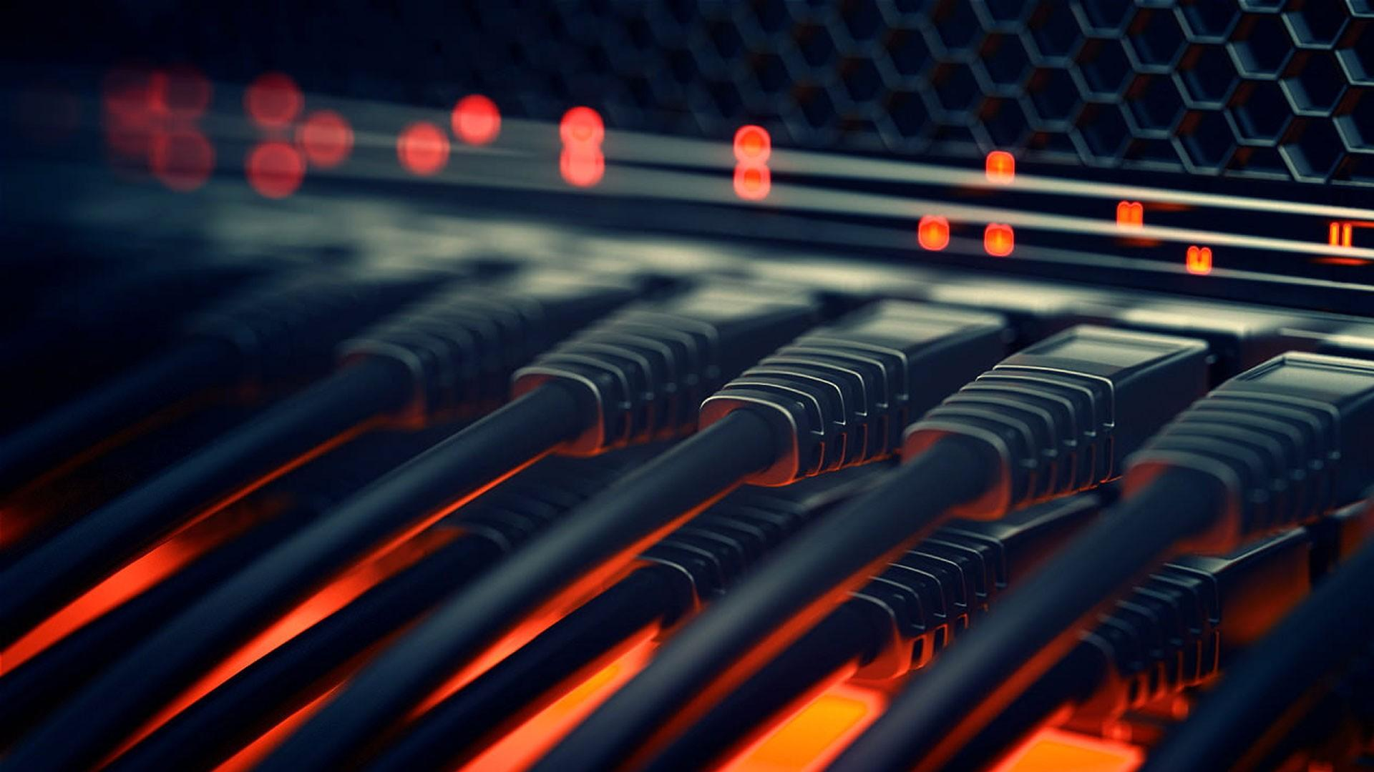
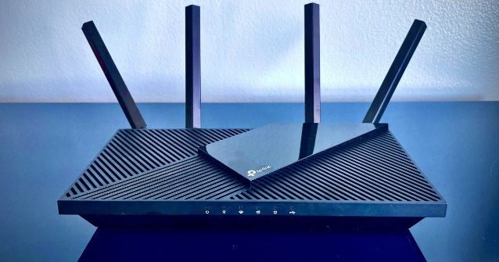
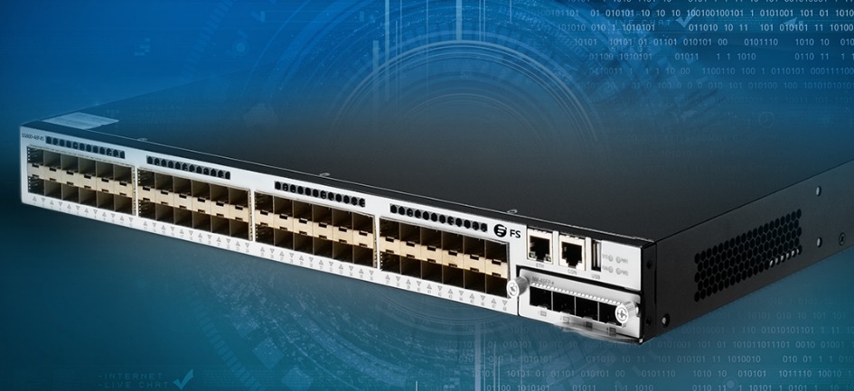
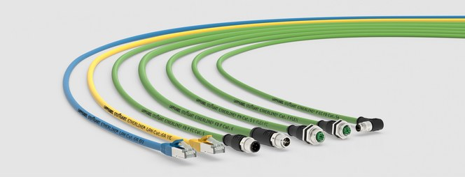
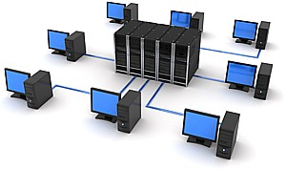
Devices used in this project:
Routers
Switches
Cables
Servers
PCs

Slide 6

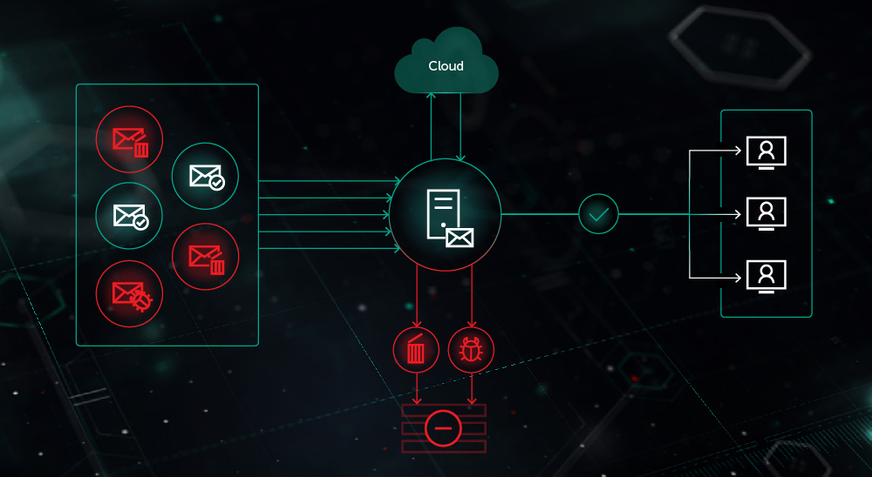
Mail server:
We are using a mail server for sending mails between clines or back end users.
For sending an email we have used SMTP and POP3 protocols.

Slide 7
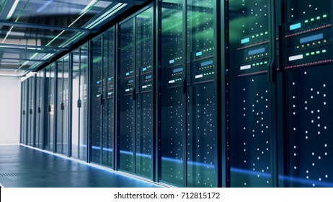
Web Server:
A web server is a server that runs websites. It's a computer program that distributes web pages as they are requisitioned. The basic objective of the web server is to store, process and deliver web pages to the users.
We are using HTTP/HTTPs for web server and we are taking Facebook page as an example in our project.

Slide 8
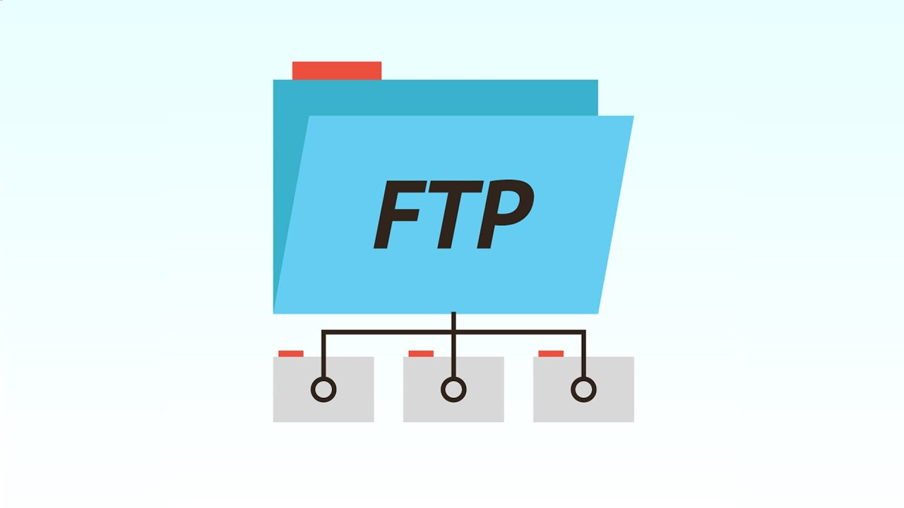
FTP Server:
FTP Server (which stands for File Transfer Protocol Server) is a software application which enables the transfer of files from one computer to another. FTP is a way to transfer files to any computer in the world that is connected to the internet.

Slide 9
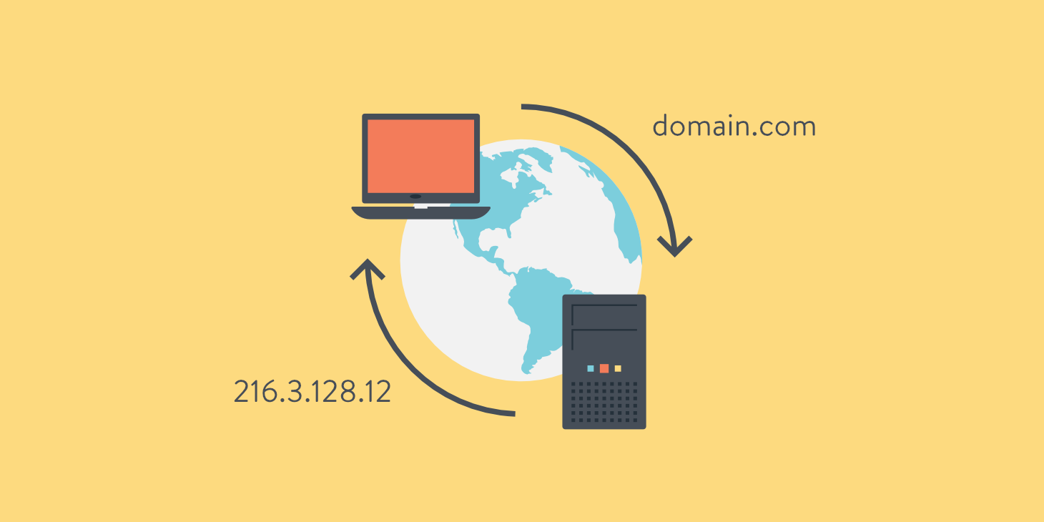
DNS Server:
The Domain Name System (DNS) turns domain names into IP addresses, which browsers use to load internet pages. Every device connected to the internet has its own IP address, which is used by other devices to locate the device.

Slide 10
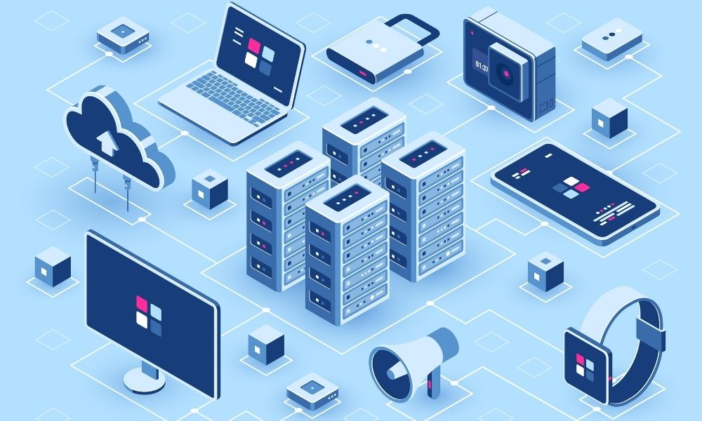
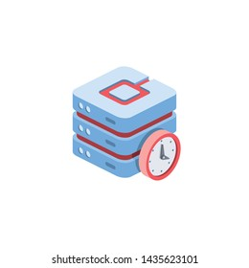
NTP Server:
Network Time Protocol (NTP) is an internet protocol that's used to synchronize the clocks on computer networks to within a few milliseconds of universal coordinated time (UTC). It enables devices to request and receive UTC from a server that, in turn, receives precise time from an atomic clock.

Slide 11
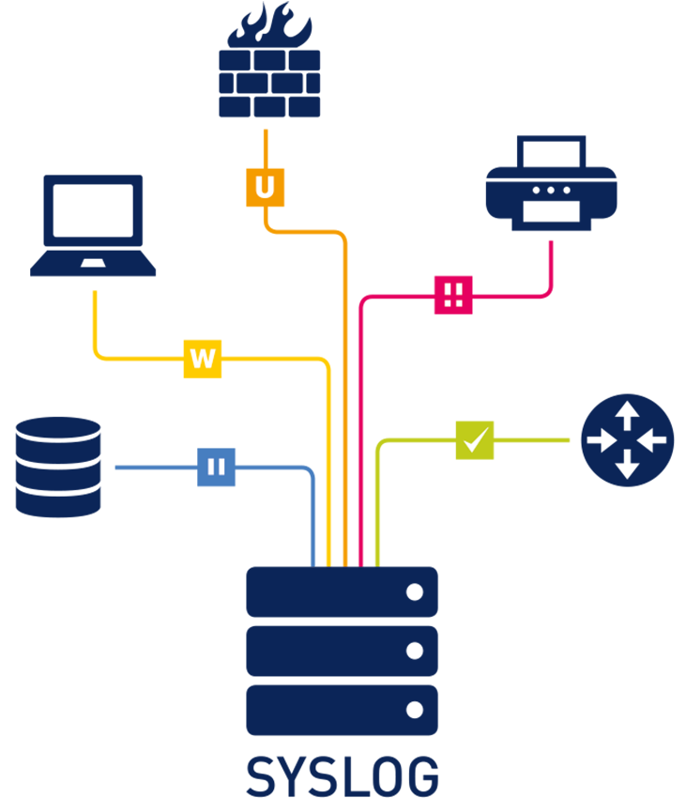
Syslog Server:
The System Logging Protocol (Syslog) is a standardized text format that network devices can use to communicate with a logging server.
The syslog standard is used by a wide range of devices, including printers, routers, and message receivers, on a variety of platforms. This allows logging data from various types of systems to be consolidated in a single location.

Slide 12

Demonstration

Slide 13

Thanks!
Any Questions?

